Slide 1
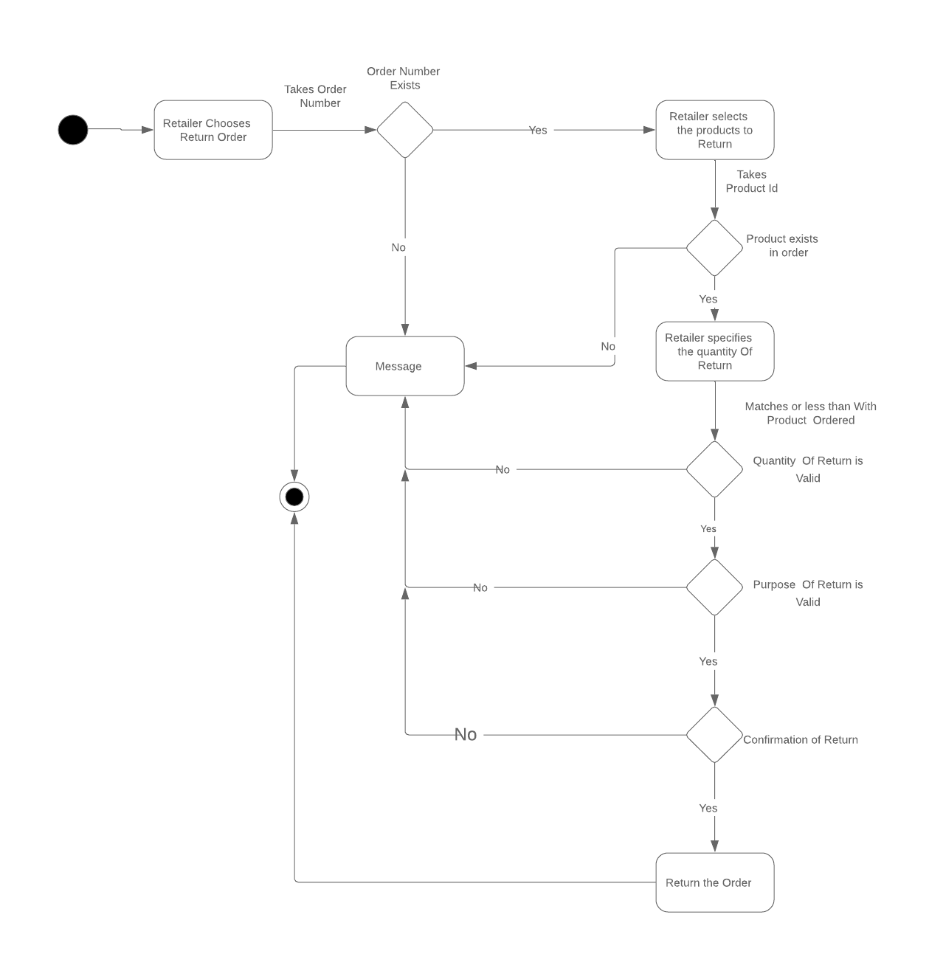

Slide 2
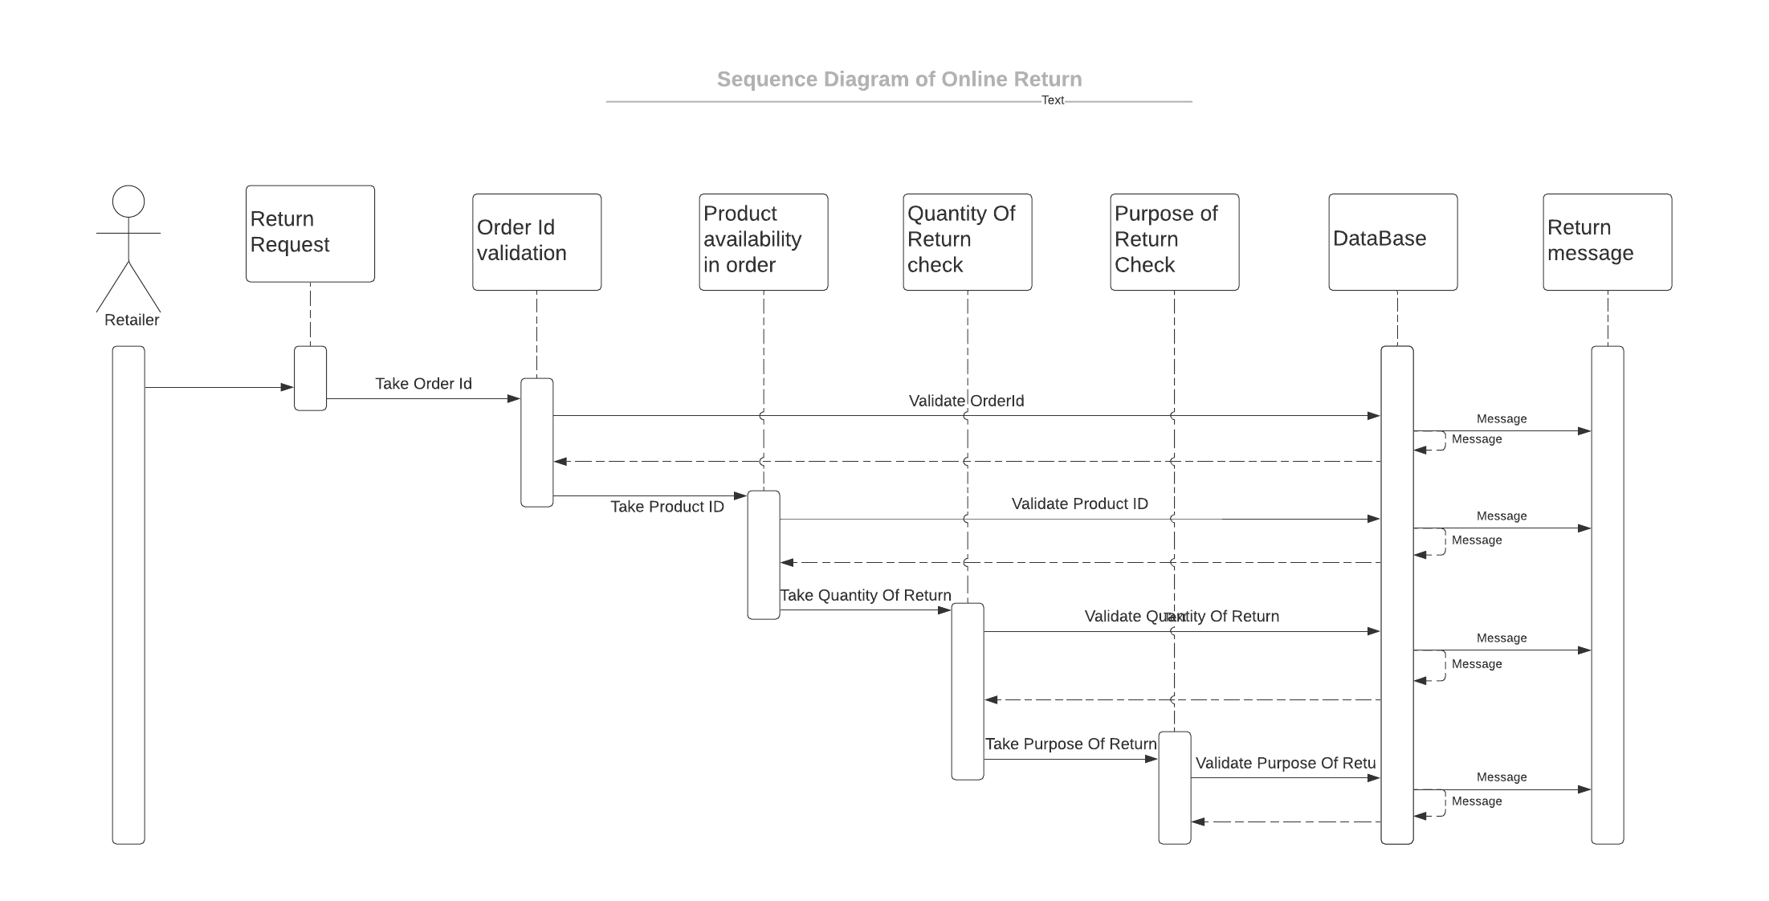

Slide 3
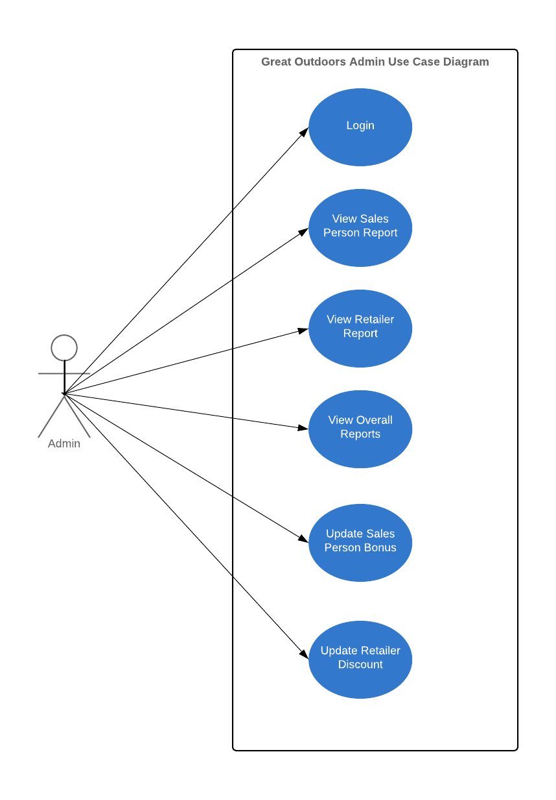

Slide 4
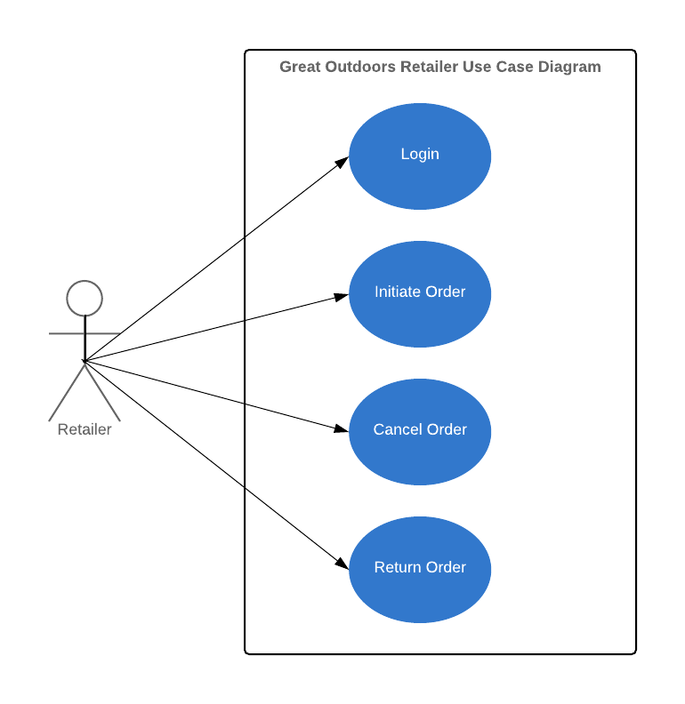

Slide 5
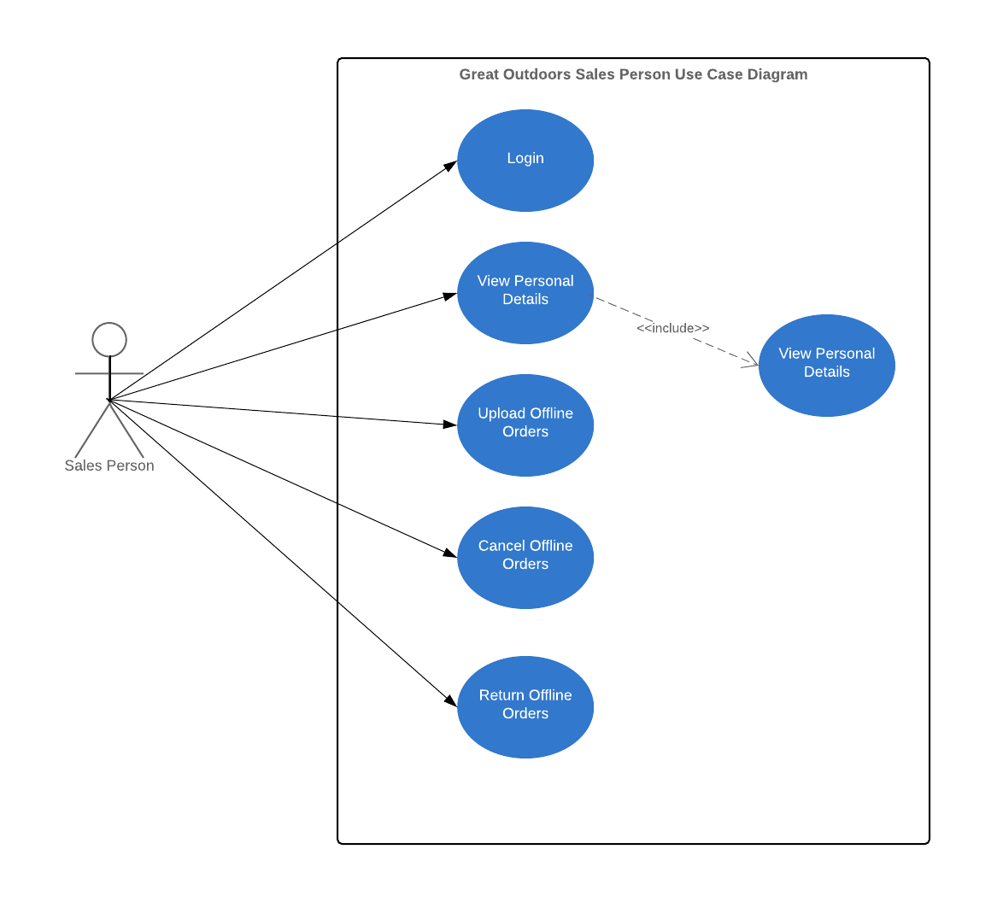

Slide 6
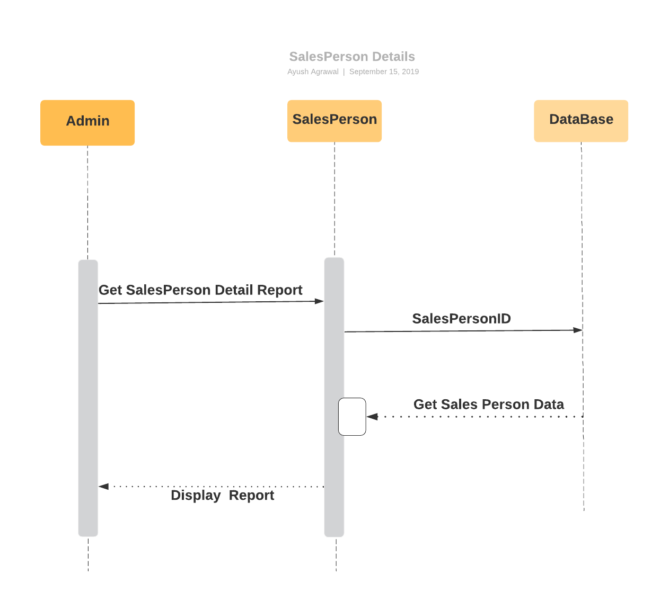
Sequence Diagram for Sales Person Details

Slide 7
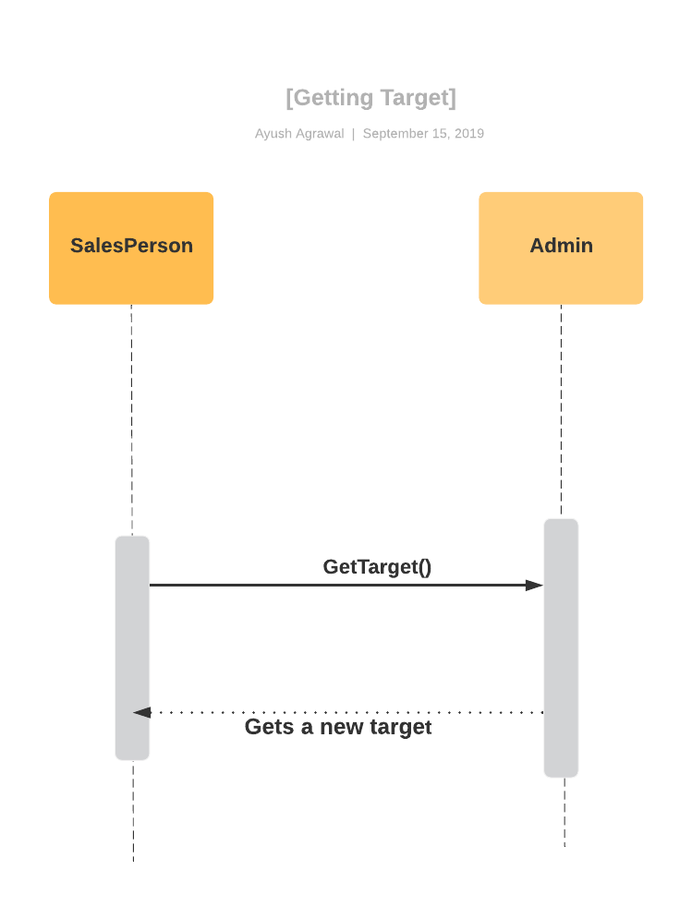
Sequence Diagram For Getting Sales Target By Sales Representatives

Slide 8
Epic And User Stories
Return Online Order
Initialization of Return Order by Retailer
Validation of Product Id , Order Id and Quantity of Product
Selection of Purpose Of Return
Confirmation of Return of product by Retailer
Generate Return Id
Generating Return Reports for different purpose of return

Slide 9
Epic And User Stories
Sales Person Details
Adding, Updating , Deleting Sales Person Details
Generating Sales Person Id
Generating Sales Person Target Report for monthly ,Quarterly and Annually
Checking Status of Target met, not met or Exceeded.

Slide 10
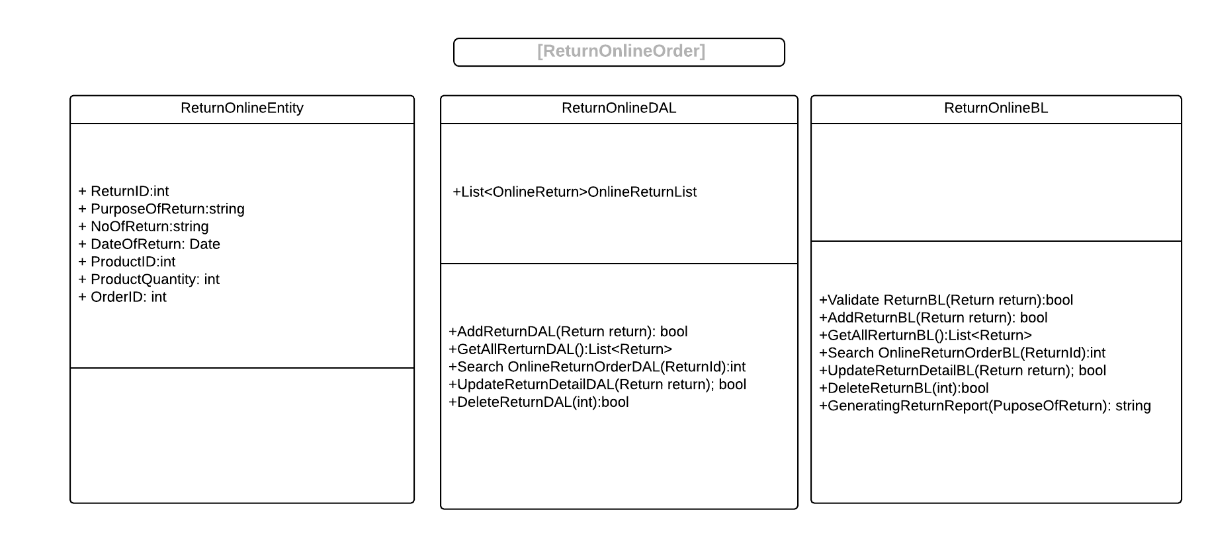
Class Diagram

Slide 11
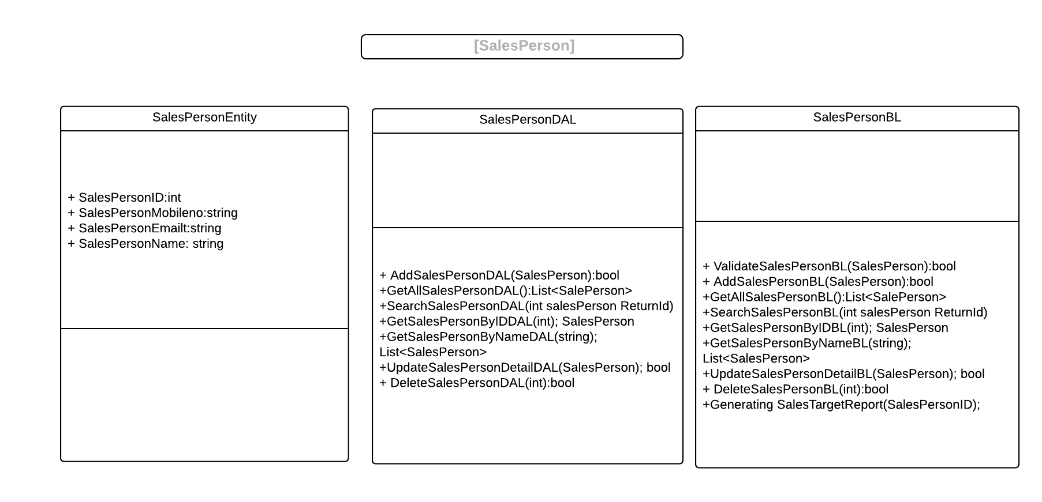
Class Diagram

